Slide 1
Step Into C++:
Some Basics
Mr. Neat
C++

Slide 2
Applications,
Applications,
Applications!

Slide 3
Let’s write our first program…
Multiply 2 integers
What kind of application is this?

Slide 4
Need to store the integers
int num1;
int num2;
int answer;
name of integer variable
means type integer

Slide 5
num1 = 5;
num2 = 4;
answer = num1*num2;
What is happening in RAM?

Slide 6
Is anything wrong
with
our calculator?

Slide 7
#include <iostream.h>
main()
{
int answer;
// blah blah calculator stuff
cout << answer;
}
from RAM to
screen

Slide 8
#include <iostream.h>
main()
{
int num1;
cin >> num1;
}
from keyboard to
RAM

Slide 9
#include <iostream.h>
main()
{
cout << “I love school”;
}
called a string

Slide 10
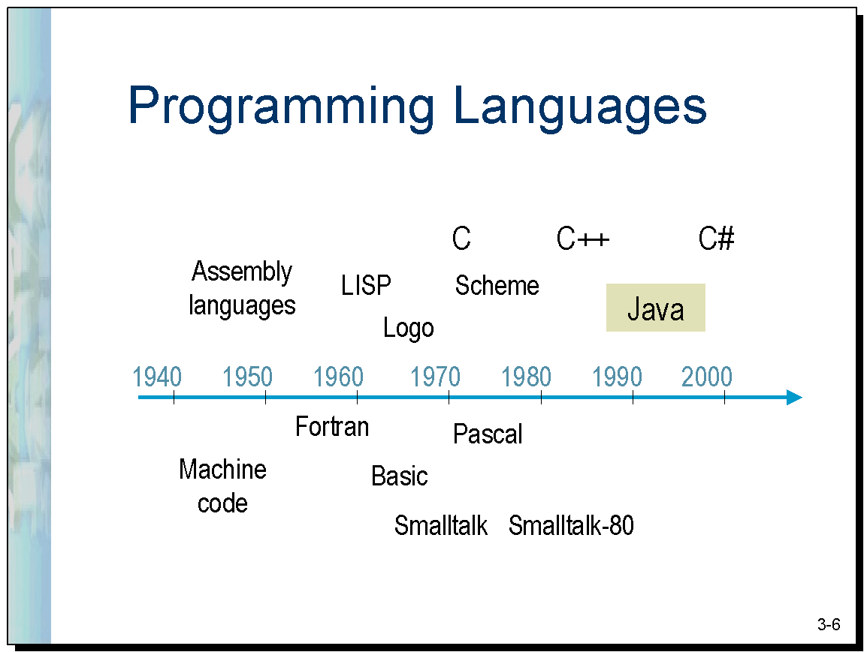

Slide 11
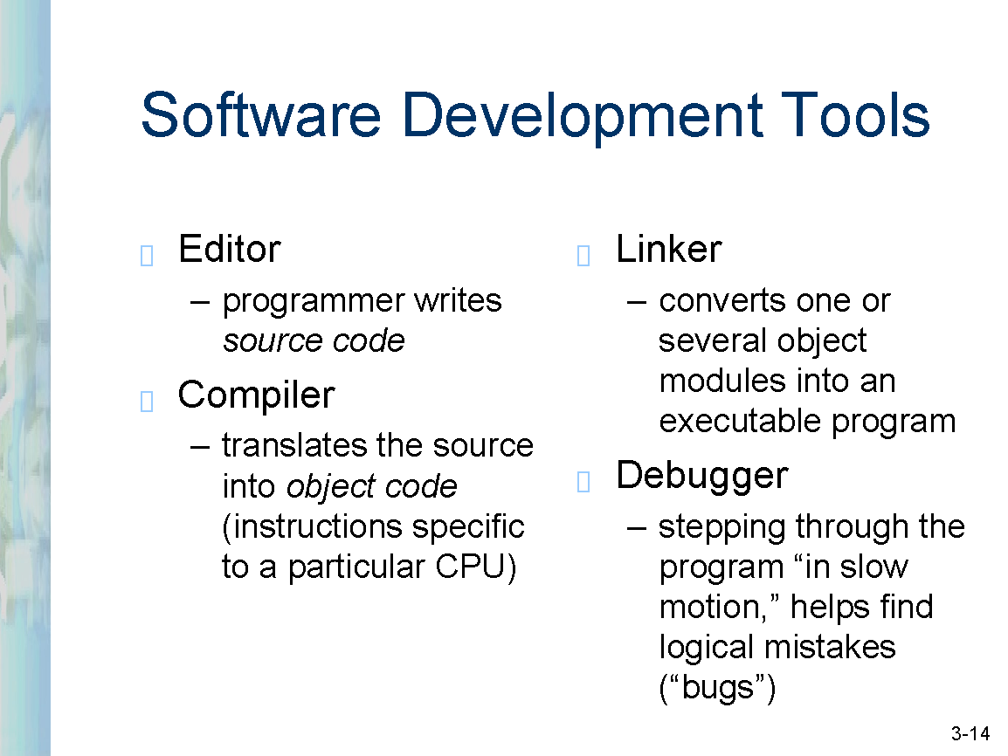
Compiled Languages

Slide 12
Running a C++ Program
practice.cpp
practice.obj
practice.exe
#include <iostream.h>
main()
{
int sue = 5;
cout << sue;
}
compiler
linker
Library with
code for
iostream.h

Slide 13
C++ Lab1
- make a calculator that
multiplies 2 integers
- display the answer on the
screen
- make it user friendly

Slide 14
Calculator Specs
Ask the user for two integers.
Load two integer variables with the two entered values.
Multiply the two values together and store the answer in a third integer variable.
Write the third integer variable (answer) to the screen.

Slide 15
Sample Output:
Please enter first number: 7
Please enter second number: 8
Answer is: 56

Slide 16
Road Map to Calculator
Make an application that:
1a – writes “I love school” to the screen.
1b – defines an integer variable and stores a value in the variable and writes ten times that value to the screen.
1c – gets a value from the keyboard and stores it in a variable and writes it back to the screen. Then replaces the variable value with ten times the original variable value and writes that new value to the screen.
1d - now make a calculator as described for Lab#1

Slide 17

Any ?’s

